Slide 1

Lesson Objectives
To understand the following topics:
Introduction to Database
Characteristics of DBMS
Data models
Relational DBMS
Database Administrator

Slide 2
What is Data?
1.1: Introduction to Database
Data (plural of the word datum) is a factual information used as a basis for
reasoning, discussion, or calculation
Data may be numerical data which may be integers or floating point numbers, and non-numerical data such as characters, date etc.
Data by itself normally doesn’t have a meaning associated with it.
e.g:-
Jack
01-jan-71
15-jun-05
50000

Slide 3
What is Information?
1.1: Introduction to Database
Related data is called as information
Information will always have a meaning and context attached to the data element
When we add meaning and context to the data it becomes information.
Employee name: Jack
Date of birth: 01-jan-71
Data of joining: 15-jun-05
Salary: 50000
Department number: 10

Slide 4
Defining Database, DBMS & Schema
1.1: Introduction to Database
Database: It is a set of inter-related data
DBMS: It is a software that manages the data
Schema: It is a set of structures and relationships, which meet a specific need
End Users
End User Tools/Applications
DBMS
Data

Slide 5
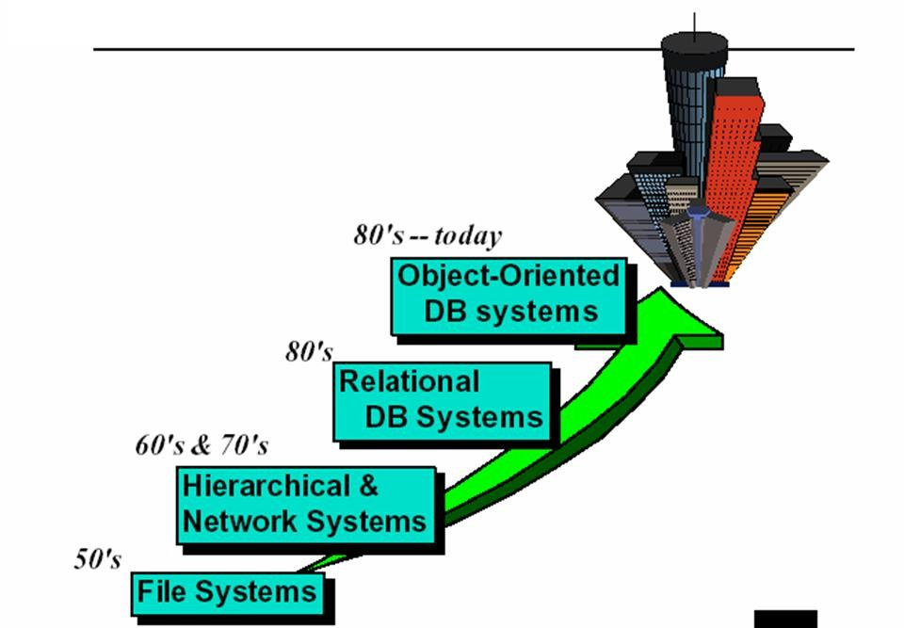
1.1: Introduction to Database
Evolution of Databases

Slide 6
Characteristics of DBMS
1.2: Features of DBMS
Given below are the characteristics of DBMS:
Control of Data Redundancy
Traditionally, same data is stored in a number of places
Gives rise to data redundancy and its disadvantages
DBMS helps in removing data redundancies by providing means of data- integration.
Sharing of Data
DBMS allows many applications to share the data.
Maintenance of Integrity
DBMS maintains the correctness, consistency, and interrelationship of data with respect to the application, which uses the data.

Slide 7
Characteristics of DBMS
1.2: Features of DBMS
Support for Transaction Control and Recovery
DBMS ensures that updates physically take place after a logical Transaction is complete.
Data Independence
In DBMS, the application programs are transparent to the physical organization and access techniques.
Availability of Productivity Tools
Tools like query language, screen and report painter, and other 4GL tools are available.

Slide 8
Characteristics of DBMS
1.2: Features of DBMS
Control over Security
DBMS provides tools with which the DBA can ensure security of the database.
Hardware Independence
Most DBMS are available across hardware platforms and operating systems.

Slide 9
Levels of Abstraction
1.2: Features of DBMS
There are three levels of database abstraction:
Conceptual Level:
The overall integrated structural organization of the database.
Physical Level:
The information about how the database is actually stored in the disk.
View / External Level:
The user view of the database. It is different for different users based on application requirement.

Slide 10
What is a Data Model?
1.3: The Data Models
The “Data model” defines the range of data structures supported and the
availability of data handling languages.
It is a collection of conceptual tools to describe:
Data
Data relationships
Constraints
There are different data models:
Hierarchical Model
Network Model
Relational Model

Slide 11
Why is Data Modeling Important?
1.3: The Data Models
Why is Data Modeling important?
The goal of the “data model” is to ensure that all the data objects required by the
database are completely and accurately represented.
The “data model” uses easily understood notations and natural language. Hence, it
can be reviewed and verified as correct by the end-users.

Slide 12
Why is Data Modeling Important?
1.3: The Data Models
Why is Data Modeling important?
The goal of the “data model” is to ensure that all the data objects required by the database are completely and accurately represented.
The “data model” uses easily understood notations and natural language. Hence, it
can be reviewed and verified as correct by the end-users.

Slide 13
Hierarchical Model
1.3: The Data Models
The Hierarchical model:
In this model, data is represented by a simple tree-structure.
Relationships between entities are represented as parent-child.
Many-to-many relationships are not
allowed.
Parents and children are tied together by
links called “pointers”.
Root
Level 1
Child
Level 1
Child
Level 2
Child
Level 2
Child
Level
2
Child
Level
2
Child

Slide 14
Hierarchical Model - Example
1.3: The Data Models
Example:
Consider a student course -
A parent can have many children
A child cannot have more than one parent
No child can exist without its parent
marks database.
In the Hierarchical model a
student can register for many
courses and gets marks for each
course.
Scode | Sname
S1 | A
Scode | Sname
S2 | B
Ccode | Cname | Marks
C1 | Physics | 65
C2 | Chemistry | 78
C3 | Maths | 83
C4 | Biology | 85
Ccode | Cname | Marks
C3 | Maths | 83
C4 | Biology | 85

Slide 15
Hierarchical Model - Possibilities
1.3: The Data Models
Possibilities in a Hierarchical model:
INSERT
Insertion of Dummy student is required to introduce a new course.
UPDATE
To change the course name of one course, the whole database has to be searched. This may result in data inconsistency.
DELETE
Deleting a student - the only one to take the course deletes course information.

Slide 16
Network Model
1.3: The Data Models
The Network model:
The Network model solves the problem of data redundancy by representing
relationships in terms of “sets” rather than “hierarchy”.
A record occurrence may have any number of immediate superiors.
The Network model supports many-to-many relationships.
There is no restriction on number of parents.
A record type can have a number of parent and child record types.
It is more complex than the Hierarchical model because of links.
It is a superset of the Hierarchical model.

Slide 17
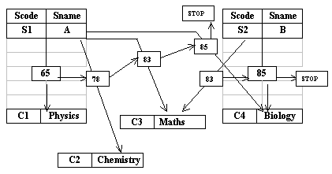
Network Model - Example
1.3: The Data Models
In the example of student course – marks, “student record” and “course record” is
linked together through “marks record”.

Slide 18
Network Model - Possibilities
1.3: The Data Models
Possibilities in a Network model:
INSERT
Inserting a “course record” or “student record” poses no problems. They can exist without any
connectors till a student takes the course.
UPDATE
Update can be done only to a particular child record.
DELETE
Deleting any record automatically adjusts the chain.

Slide 19
Relational Model
1.3: The Data Models
The Relational model:
The Relational model developed out of the work done by Dr. E. F. Codd at IBM in the
late 1960s. He was looking for ways to solve the problems with the existing models.
At the core of the Relational model is the concept of a “table” (also called a “relation”), which stores all data.
Each “table” is made up of:
“records” (i.e. horizontal rows that are also known as “tuples”), and
“fields” (i.e. vertical columns that are also known as “attributes”)

Slide 20
Relational Model
1.3: The Data Models
The Relational model:
Examples of RDBMS:
Oracle
Informix
Sybase
Because of lack of linkages, the Relational
model is easier to understand and implement.
Student Table
Scode | Sname
S1 | A
S2 | B
Course Table
Ccode | Cname
C1 | Physics
C2 | Chemistr y
C3 | Maths
C4 | Biology
Marks Table
Ccode | Scode | Marks
C1 | S1 | 65
C2 | S1 | 78
C3 | S1 | 83
C4 | S1 | 85
C3 | S2 | 83
C4 | S2 | 85

Slide 21
Relational Model - Possibilities
1.3: The Data Models
Possibilities in a Relational model:
INSERT
Inserting a “course record” or “student record” poses no problems because tables are
separate.
UPDATE
Update can be done only to a particular table.
DELETE
Deleting any record affects only a particular table.

Slide 22


Relational Tables
1.4: Relational DBMS
Examples of Relational tables:
“column” or “attribute”
Dept table
Deptno | Dname | Loc
10 | Accounting | New York
20 | Research | Dallas
30 | Sales | Chicago
40 | Operations | Boston
“row” or “tuple”
Emp table
Empno | Empname | Job | Mgr | Deptno
7369 | Smith | Clerk | 7902 | 20
7499 | Allen | Salesman | 7839 | 30
7566 | Jones | Manager | 7839 | 20
7839 | King | President |  | 10
7902 | Ford | Analyst | 7566 | 20

Slide 23
Relational Tables - Properties
1.4: Relational DBMS
Properties of Relational Data Entities:
Tables must satisfy the following properties to be classified as relational:
Entries of attributes should be single-valued.
Entries of attributes should be of the same kind.
No two rows should be identical.
The order of attributes is unimportant.
The order of rows is unimportant.
Every column can be uniquely identified.

Slide 24
Data Integrity
1.4: Relational DBMS
“Data Integrity” is the assurance that data is consistent, correct, and
accessible throughout the database.
Some of the important types of integrities are:
Entity Integrity:
It ensures that no “records” are duplicated, and that no “attributes” that make up the primary
key are NULL.
It is one of the properties that is necessary to ensure the consistency of the database.

Slide 25
Data Integrity
1.4: Relational DBMS
Foreign Key and Referential Integrity
The Referential Integrity rule: If a Foreign key in table A refers to the Primary key
in table B, then every value of the Foreign key in table A must be null or must be available in table B.
Unique Constraint:
It is a single field or combination of fields that uniquely defines a tuple or row.
It ensures that every value in the specified key is unique.
A table can have any number of unique constraints, with at most one unique constraint defined as a Primary key.
A unique constraint can contain NULL value.

Slide 26
Data Integrity
1.4: Relational DBMS
Column Constraint:
It specifies restrictions on the values that can be taken by a column.
DEPT table
Deptno | Dname | Loc
10 | Accounting | New York
20 | Research | Dallas
EMP table
Empno | Empname | Job | Mgr | Deptno
7369 | Smith | Clerk | 7902 | 20
7499 | Allen | Salesma n | 7839 | 30

Slide 27
Database Administrator
1.5 Database Administrator
A Database Administrator (DBA) is the database architect.
DBA is responsible for the design and implementation of new databases, and:
centrally manages the database.
decides on the type of data, internal structures, and their relationships
ensures the security of the database
controls access to the data through user codes and passwords
can restrict the views or operations that the users can perform on the database

Slide 28

Summary
In this lesson, you have learnt:
What is a Database?
Characteristics of DBMS
The Data models, including:
the Hierarchical model
the Network model
the Relational model
Relational DBMS (RDBMS)
What is Data Integrity

Slide 29

Review Question
Question 1: A DBA .
Option 1: ensures the security of the application server.
Option 2: controls access to the data through the user codes and passwords.
Option 3: manages users.
Question 2: The Physical Level is .
Option 1: the overall structural organization of the d/b.
Option 2: the information about how the database is actually stored in the disk.
Option 3: the user view of the database.

Slide 30
Review Question
Question 3: There are different data models such as .
Question 4: In Network model, each table is made up
“tuples” and “fields”.
True / False
Question 5: A table can have any number of “Unique constraints”.
True / False

Slide 31
Review Question: Match the Following
1. Hierarchical model
2. Network model
3. Data redundancy
4. In DBMS
a) Inconsistencies may creep in.
b) Many-to-many relationships are not allowed.
c) It is a superset of the Hierarchical model.
d) Application programs are transparent to the physical organization and access techniques.

